Slide 1
Life Cycle Models: Scrum

Slide 2
Practice Questions
What are the stages of iterative waterfall model?
What are the disadvantages of the iterative waterfall model?
Why has agile model become so popular?
What difficulties might be faced if no life cycle model is followed for a certain large project?

Slide 3
Suggest Suitable Life Cycle Model
A software for an academic institution to automate its:
Course registration and grading
Fee collection
Staff salary
Purchase and store inventory
The software would be developed by tailoring a similar software that was developed for another educational institution:
70% reuse
10% new code and 20% modification

Slide 4
Practice Questions
Which types of risks can be better handled using the spiral model compared to the prototyping model?
Which type of process model is suitable for the following projects:
A customization software
A payroll software for contract employees that would be add on to an existing payroll software

Slide 5
Practice Questions
Which lifecycle model would you select for the following project which has been awarded to us by a mobile phone vendor:
A new mobile operating system by upgrading the existing operating system
Needs to work well efficiently with 4G systems
Power usage minimization
Directly upload backup data on a cloud infrastructure maintained by the mobile phone vendor

Slide 6
Scrum

Slide 7
Scrum: Characteristics
Self-organizing teams
Product progresses in a series of month-long sprints
Requirements are captured as items in a list of product backlog
One of the agile processes

Slide 8
Daily Scrum
Sprint
planning
Sprint
review
Scrum
Sprint
backlog
Product backlog
Product
increment

Slide 9
Sprint
Scrum projects progress in a series of “sprints”
Analogous to XP iterations or time boxes
Target duration is one month
Software increment is designed, coded, and tested during the sprint
No changes entertained during a sprint

Slide 10
Scrum Framework
Roles : Product Owner, Scrum Master, Team
Ceremonies : Sprint Planning, Sprint Review, Sprint Retrospective, and Daily Scrum Meeting
Artifacts : Product Backlog, Sprint Backlog, and Burndown Chart

Slide 11
Key Roles and Responsibilities in a Scrum Team
Product Owner
Represents customers’ views and interests.
Development Team
Team of five-nine people with cross-functional skill sets.
Scrum Master (aka Project Manager)
Facilitates scrum process and resolves impediments at the team and organization level by acting as a buffer between the team and outside interference.

Slide 12
Product Owner
Defines the features of the product
Decides on release date and content
Prioritizes features according to usefullness
Adjusts features and priority every iteration, as needed
Accepts or reject work results.

Slide 13
The Scrum Master
Represents management in the project
Removes impediments
Ensures that the team is fully functional and productive
Enables close cooperation across all roles and functions
Shields the team from external interferences

Slide 14
Scrum Team
Typically 5-10 people
Cross-functional
QA, Programmers, UI Designers, etc.
Teams are self-organizing
Membership can change only between sprints

Slide 15
Sprint
Fundamental process flow of Scrum
It is usually a month-long iteration:
during this time an incremental product functionality completed
NO outside influence allowed to interfere with the Scrum team during the Sprint
Each day begins with the Daily Scrum Meeting

Slide 16
Ceremonies
Sprint Planning Meeting
Daily Scrum
Sprint Review Meeting

Slide 17
Sprint Planning
Goal is to produce Sprint Backlog
Product owner works with the Team to negotiate what Backlog Items
Scrum Master ensures Team agrees to realistic goals

Slide 18
Daily Scrum
Daily
15-minutes
Stand-up meeting
Not for problem solving
Three questions:
What did you do yesterday
What will you do today?
What obstacles are in your way?

Slide 19
Daily Scrum
Is NOT a problem solving session
Is NOT a way to collect information about WHO is behind the schedule
Is a meeting in which team members review what is done and make informal commitments to each other and to the Scrum Master
Is a good way for a Scrum Master to track the progress of the Team

Slide 20
Sprint Review Meeting
Team presents what it accomplished during the sprint
Typically takes the form of a demo of new features
Informal
2-hour prep time rule
Participants
Customers
Management
Product Owner
Other team members

Slide 21
Product Backlog
A list of all desired work on the project
Usually a combination of
story-based work (“let user search and replace”)
task-based work (“improve exception handling”)
List is prioritized by the Product Owner
Typically a Product Manager, Marketing, Internal Customer, etc.

Slide 22
Product Backlog
Requirements for a system, expressed as a prioritized list of Backlog Items
Managed and owned by Product Owner
Spreadsheet (typically)

Slide 23
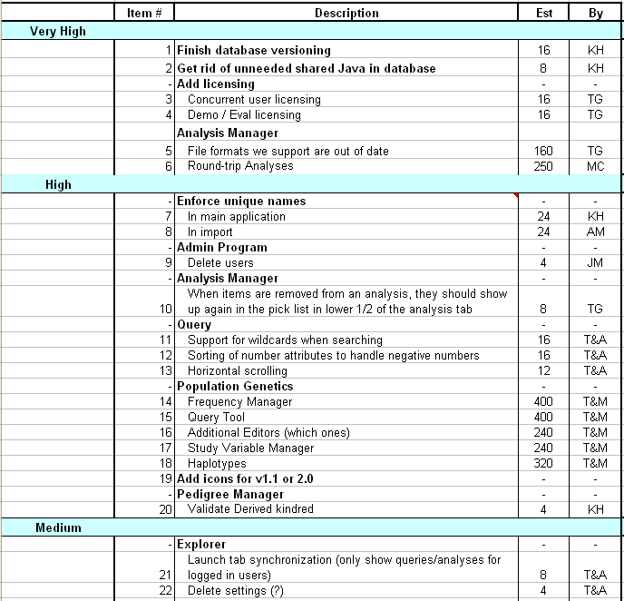
Sample Product Backlog

Slide 24
Sprint Backlog
A subset of Product Backlog Items, which define the work for a Sprint
Created by Team members
Each Item has it’s own status
Updated daily

Slide 25
Sprint Backlog during the Sprint
Changes occur:
Team adds new tasks whenever they need to in order to meet the Sprint Goal
Team can remove unnecessary tasks
But: Sprint Backlog can only be updated by the team
Estimates are updated whenever there’s new information

Slide 26
Burn down Charts
Are used to represent “work done”.
Are remarkably simple but effective Information disseminators
3 Types:
Sprint Burn down Chart (progress of the Sprint)
Release Burn down Chart (progress of release)
Product Burn down chart (progress of the Product)

Slide 27
Sprint Burn down Chart
Depicts the total Sprint Backlog hours remaining per day
Shows the estimated amount of time to complete
Ideally should burn down to zero to the end of the Sprint
Actually is not a straight line

Slide 28
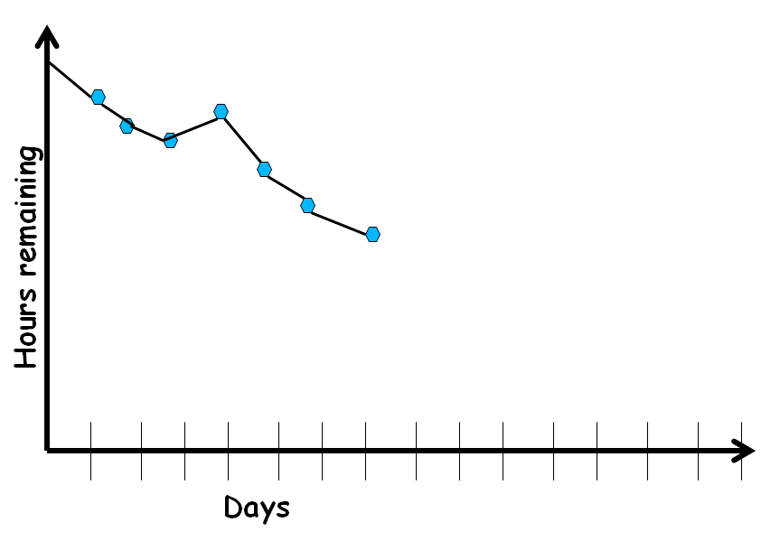
Sprint Burndown Chart

Slide 29
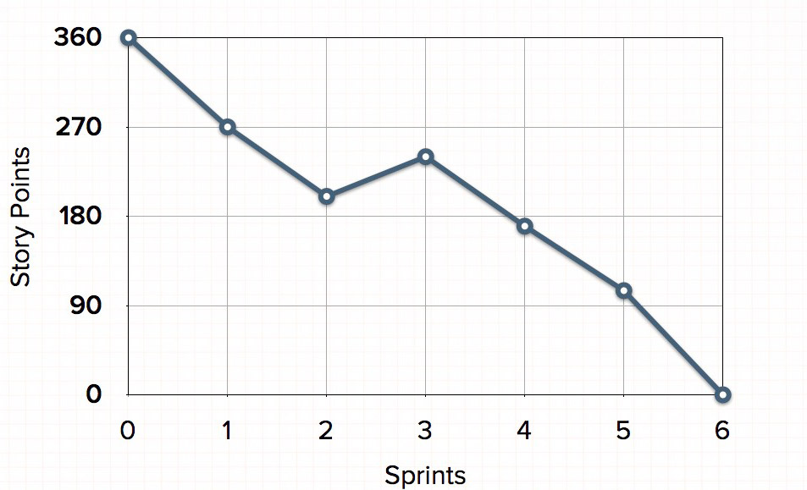
Release Burndown Chart
Will the release be done on right time?
How many more sprints?
X-axis: sprints
Y-axis: amount of story points remaining

Slide 30
Product Burndown Chart
Is a “big picture” view of project’s progress (all the releases)
Actual
burndown
Story
points
Expected
burndown
Sprint

Slide 31
Scalability of Scrum
A typical Scrum team is 6-10 people
Jeff Sutherland - up to over 800 people
"Scrum of Scrums" or "Meta-Scrum“

Slide 32
Thank You!!

